Slide 1
Direct Methods

Slide 2
Direct Methods
Direct method search using function evaluations only
Also called zero-order, black box, pattern search, or derivative-free methods

Slide 3
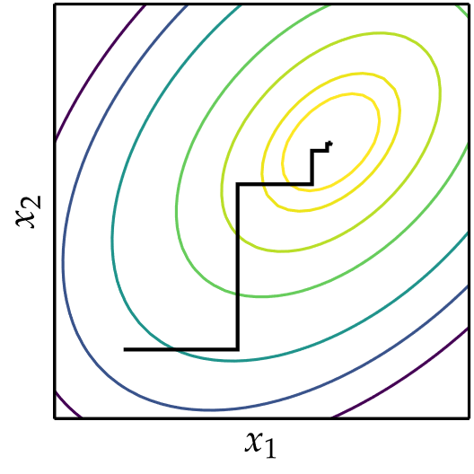
Cyclic Coordinate Search
Also known as coordinate descent, or taxicab search
Performs line search in alternating coordinate directions

Slide 4
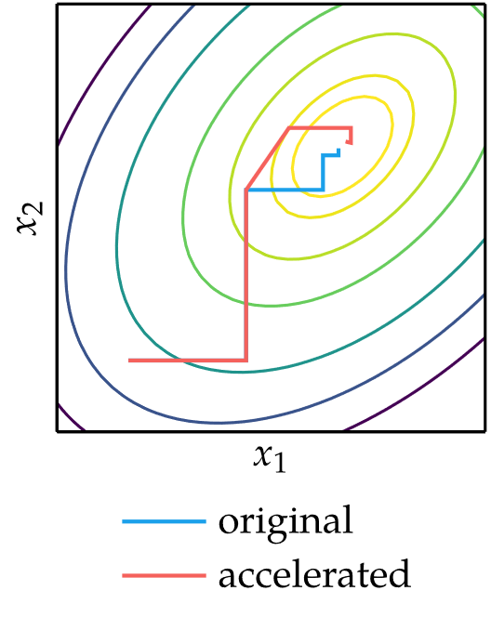
Cyclic Coordinate Search
Can be augmented to accelerate convergence

Slide 5
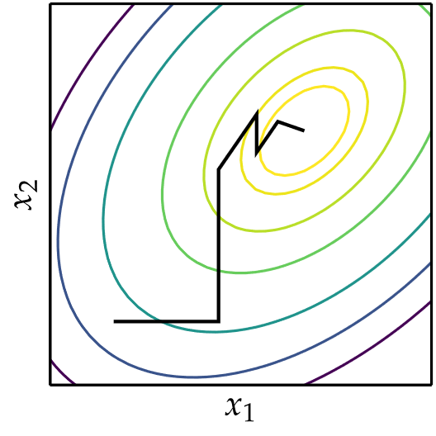
Powell’s Method
Similar to Cyclic Coordinate Search, but can search in non-orthogonal directions

Slide 6
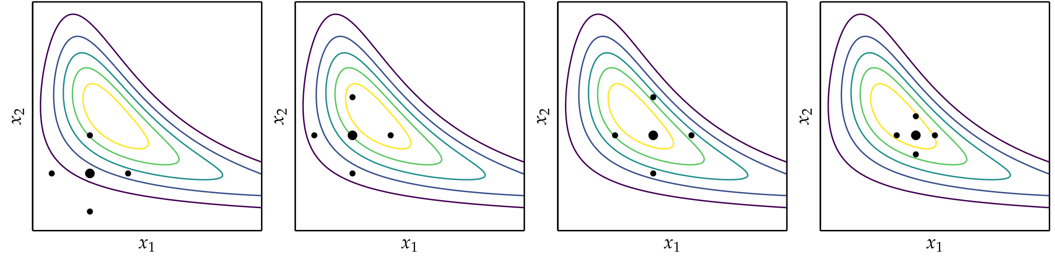
Hooke-Jeeves

Slide 7
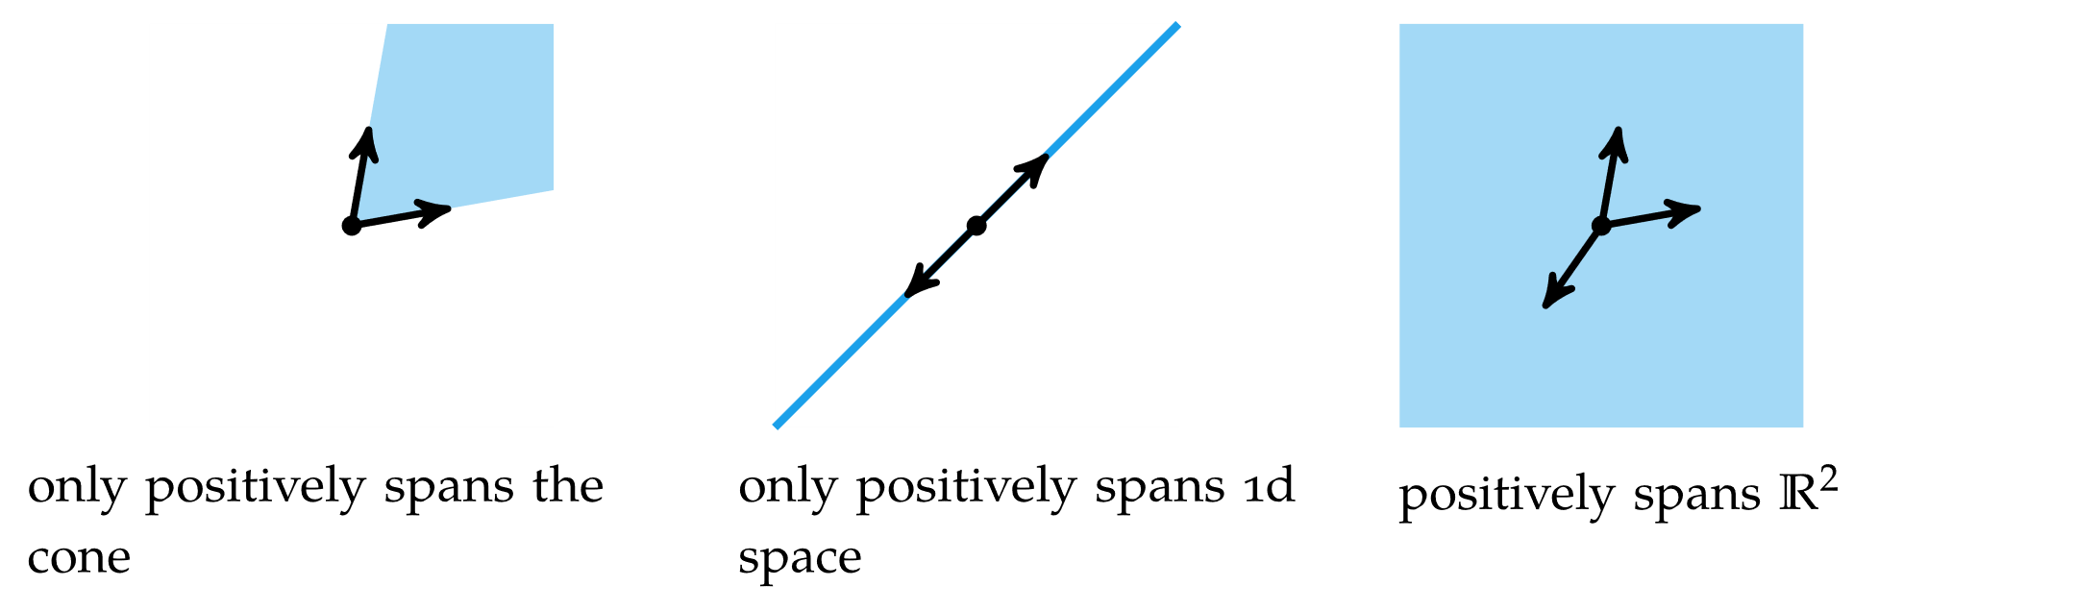
Generalized Pattern Search
Generalization of Hooke-Jeeves method
Searches in set of directions that positively spans search space

Slide 8
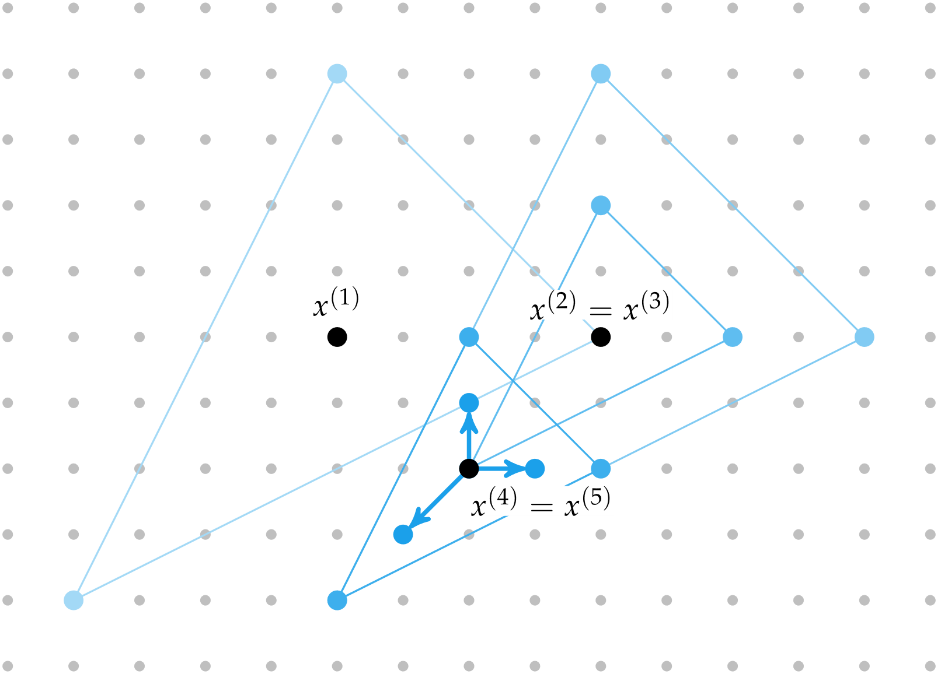
Generalized Pattern Search

Slide 9
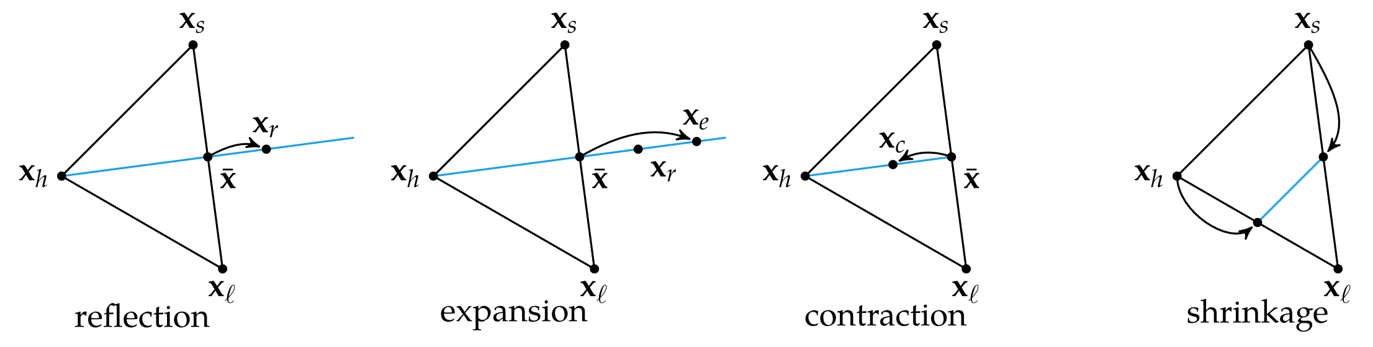
Nelder-Mead Simplex Method
Uses simple algorithm to traverse search space using set of points defining a simplex

Slide 10
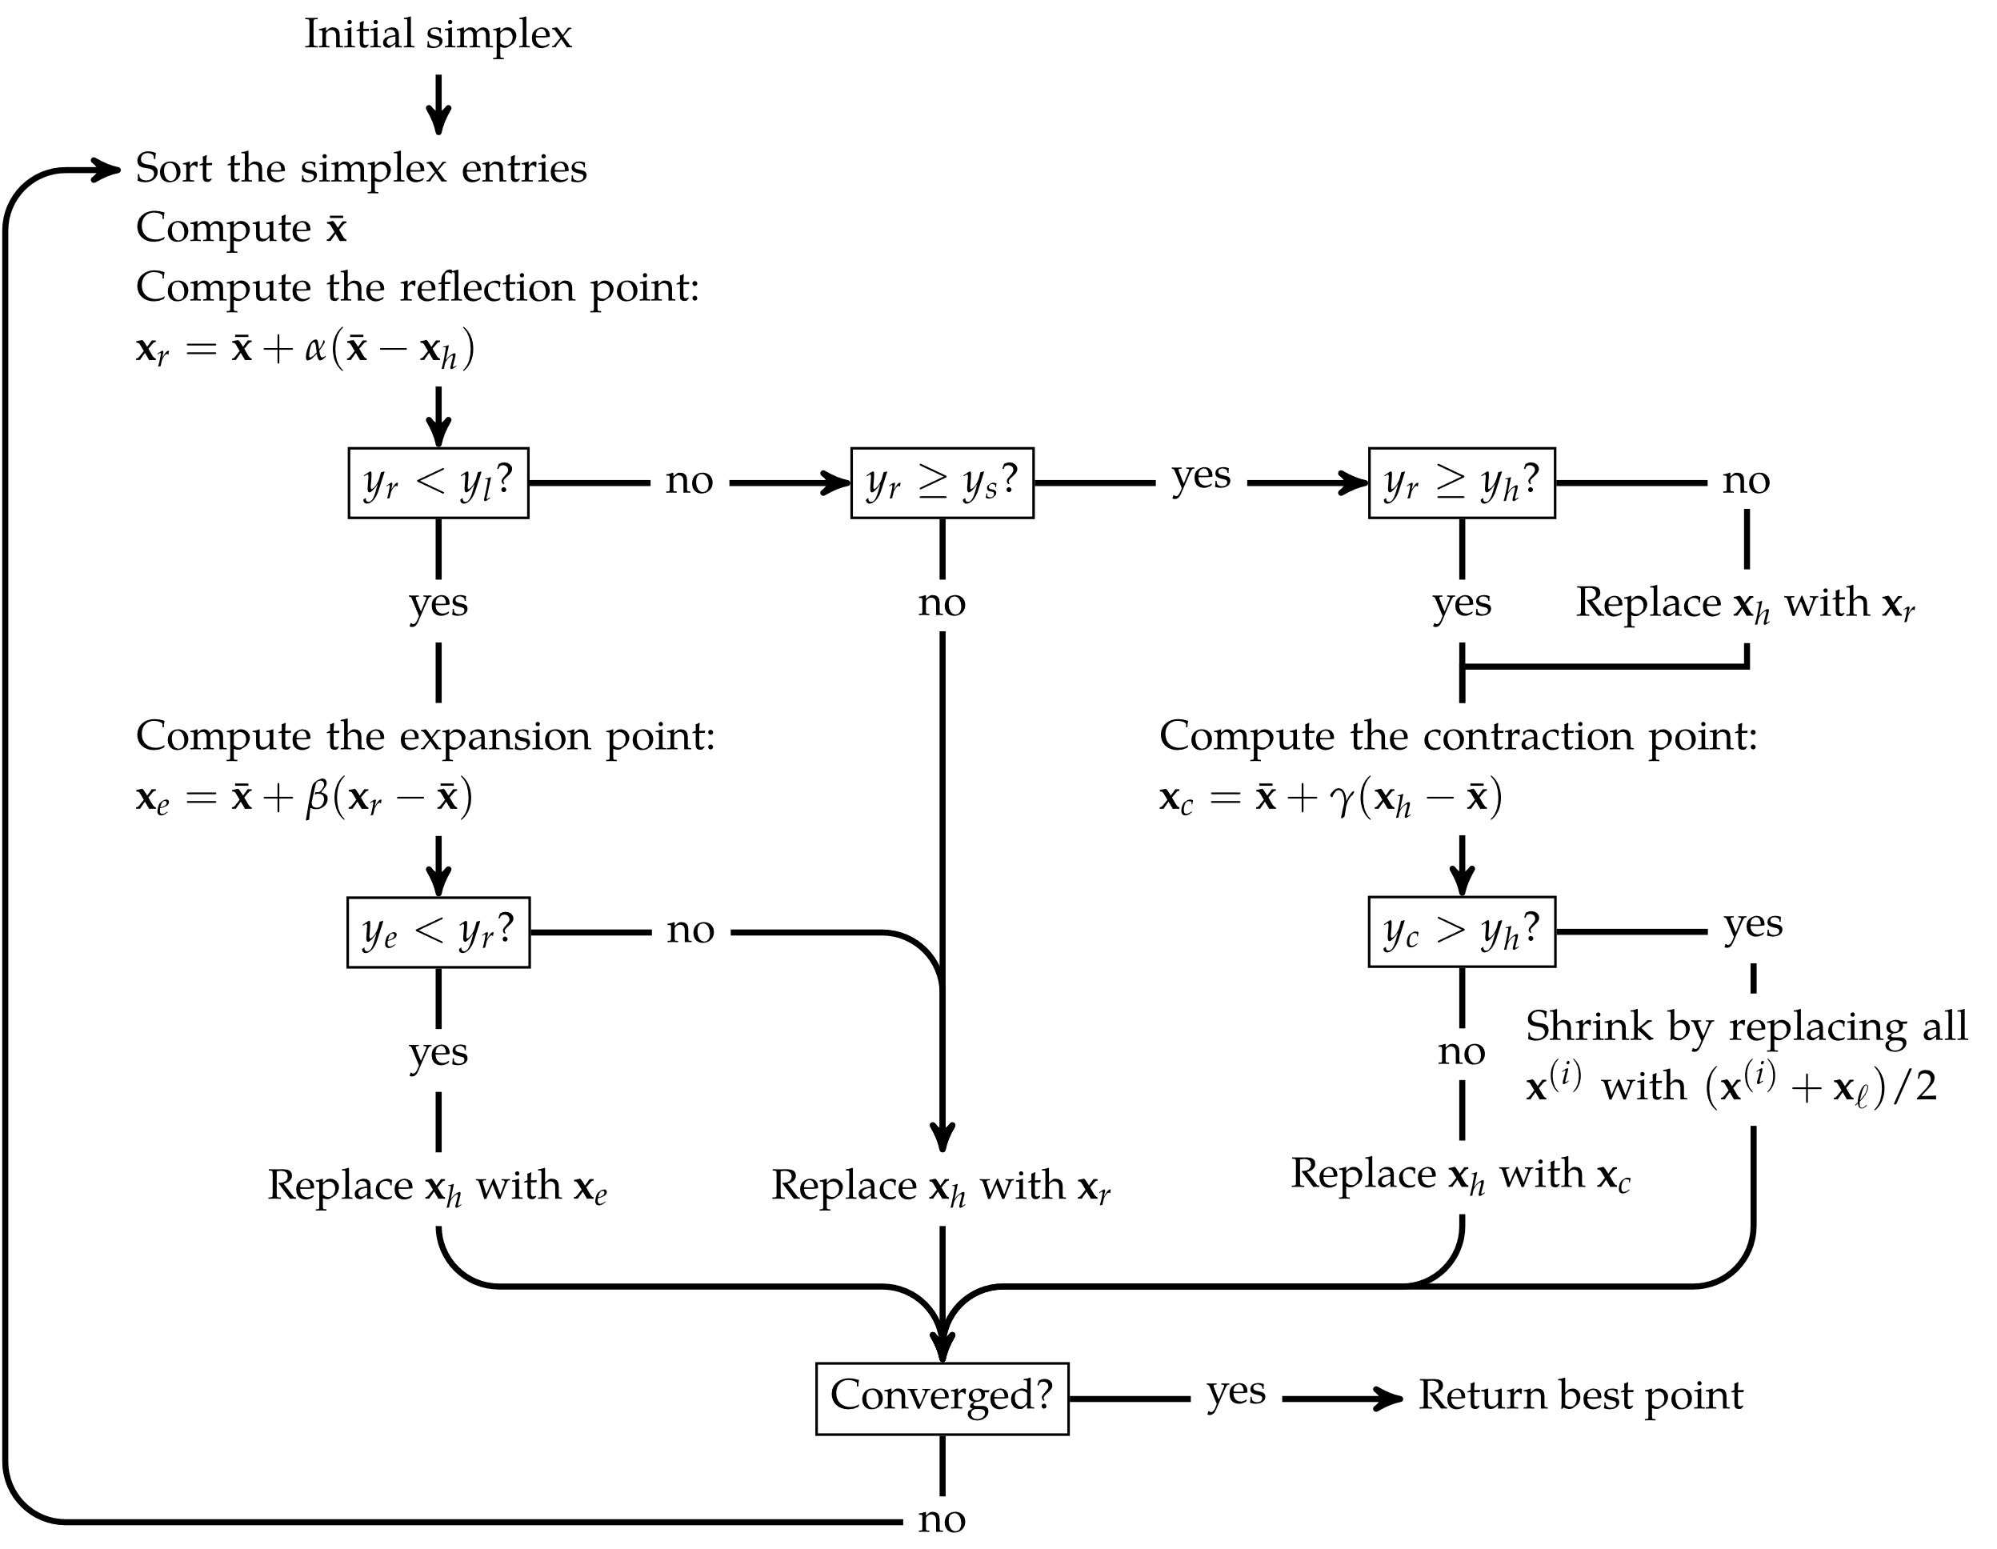
Nelder-Mead Simplex Method

Slide 11
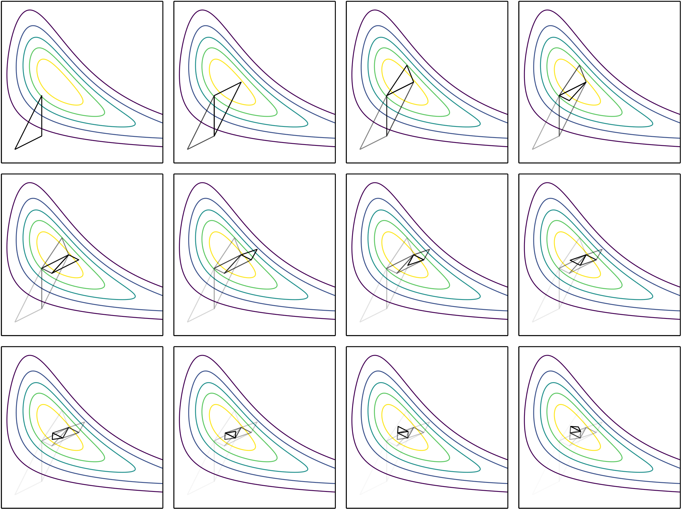
Nelder-Mead Simplex Method

Slide 12
Divided Rectangles
Also called DIRECT for Divided RECTangles
Same approach as Shubert-Piyavskii method, but does not need to specify Lipschitz constant and is more efficiently expanded to multiple dimensions

Slide 13
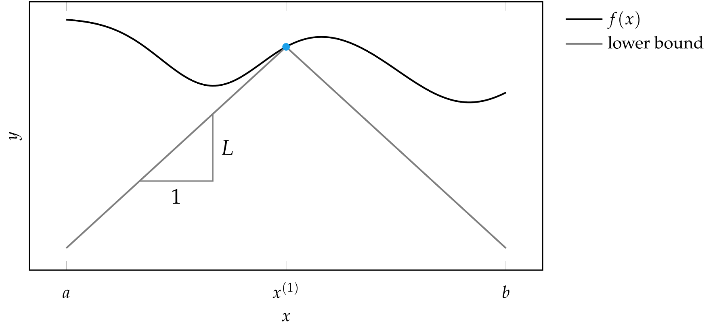
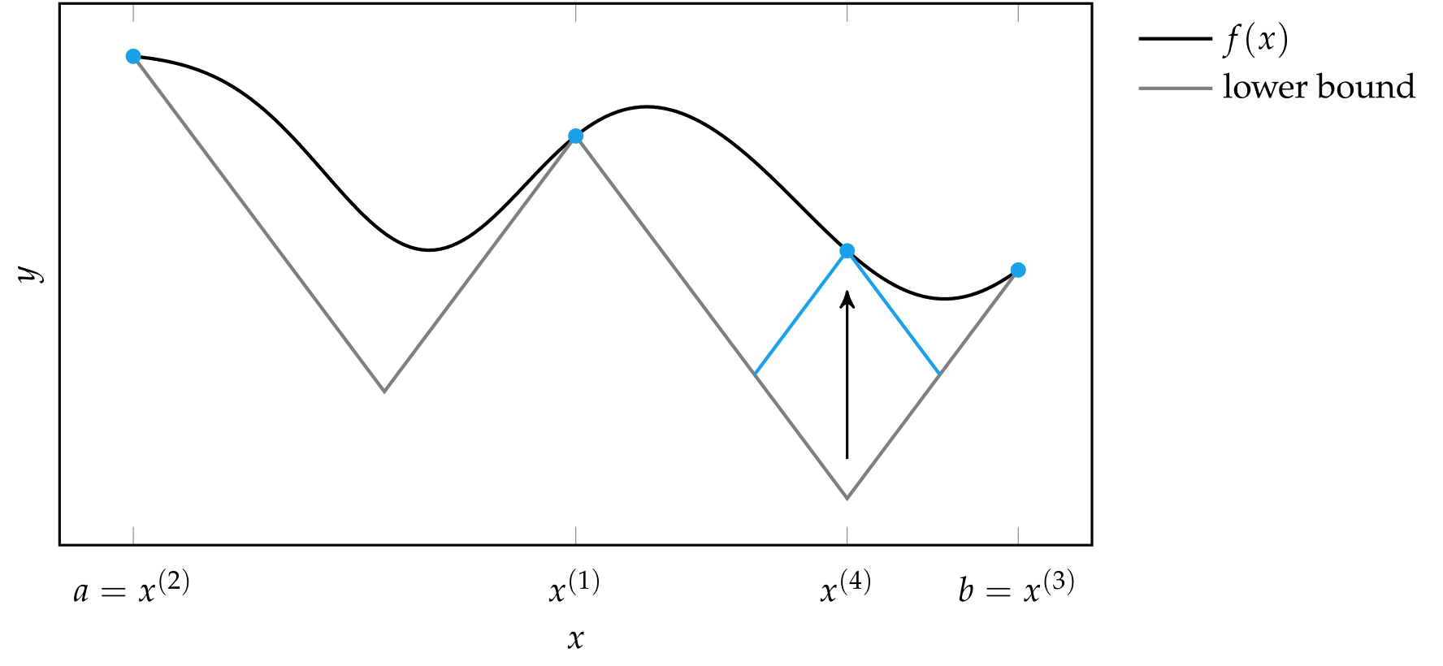
Divided Rectangles
Recall from Shubert-Piyavskii, a Lipshitz constant is used to provide a lower bound on the function, and a function evaluation is made where this bound is lowest

Slide 14
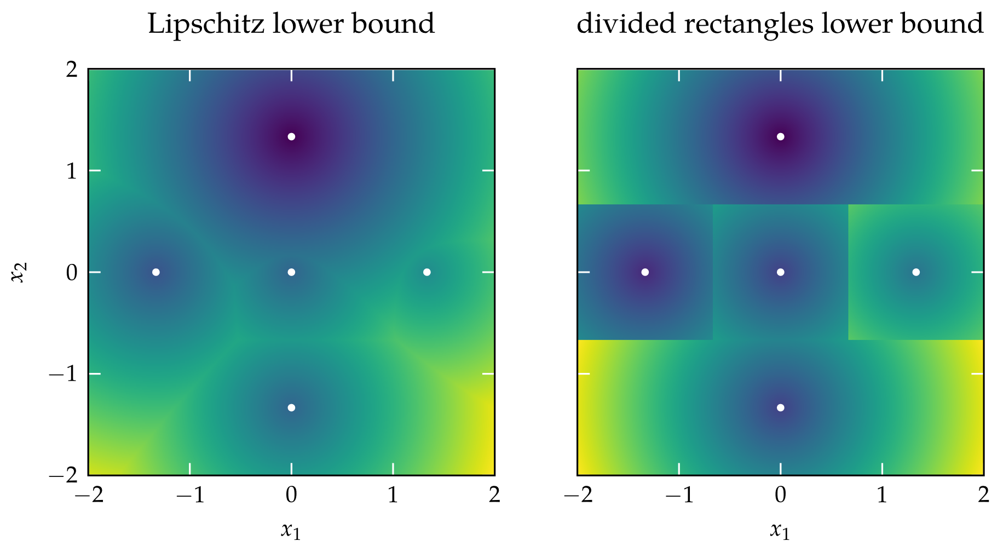
Divided Rectangles
In multiple dimensions, the geometry of these cone intersections can become very complicated
DIRECT simplifies geometry using subdivided rectangles

Slide 15
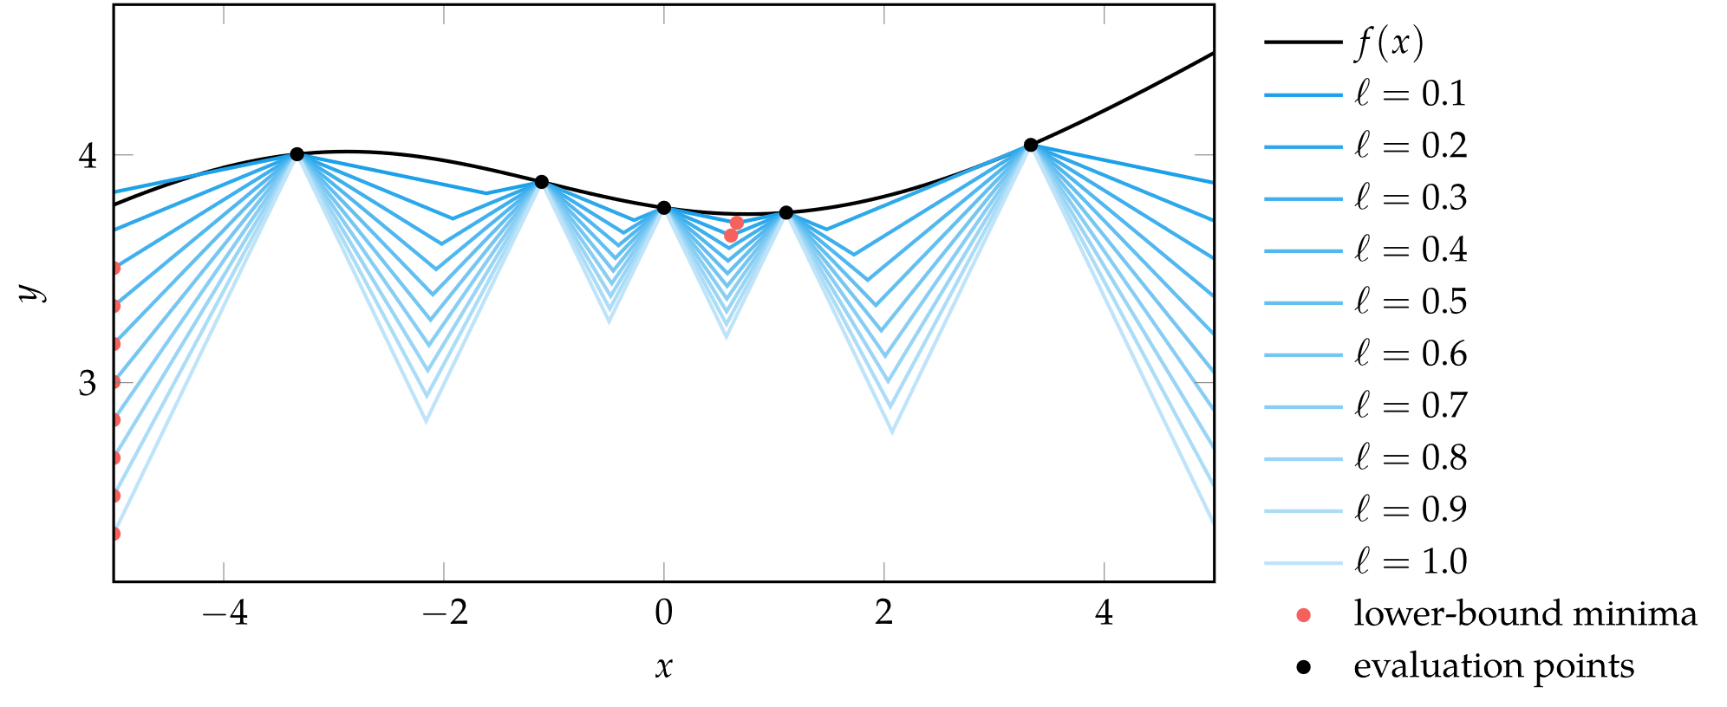
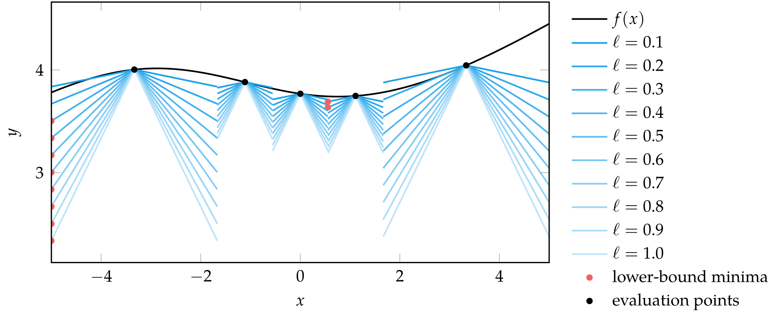
Divided Rectangles
DIRECT does not assume a Lipschitz constant is known

Slide 16
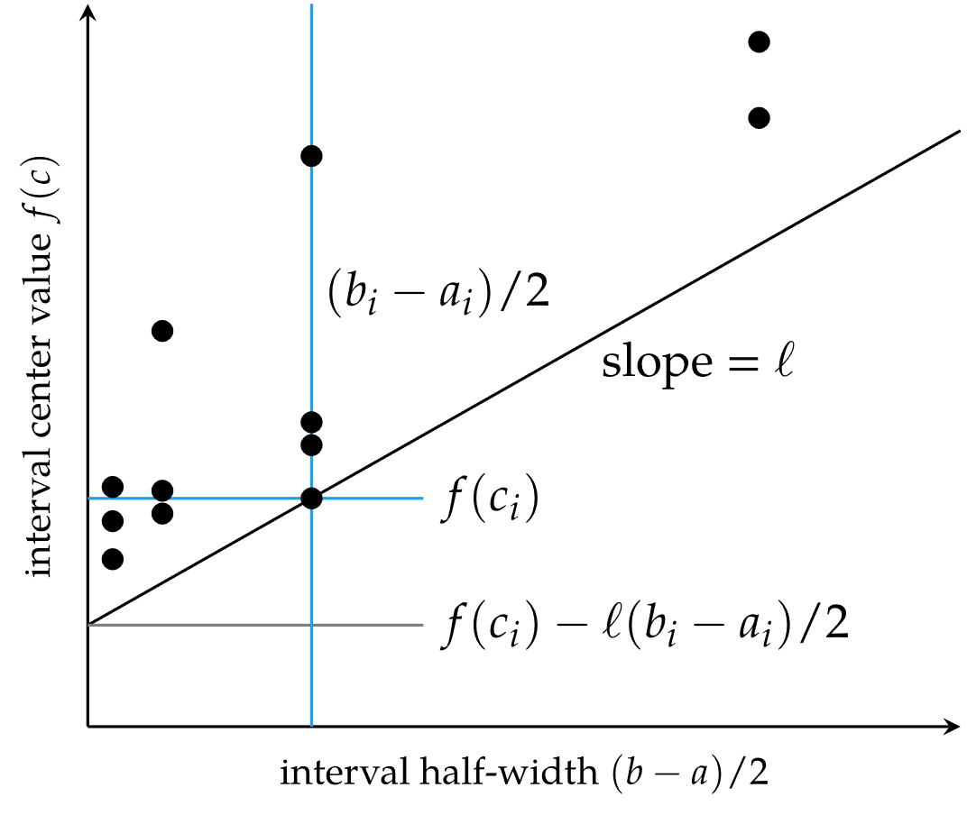
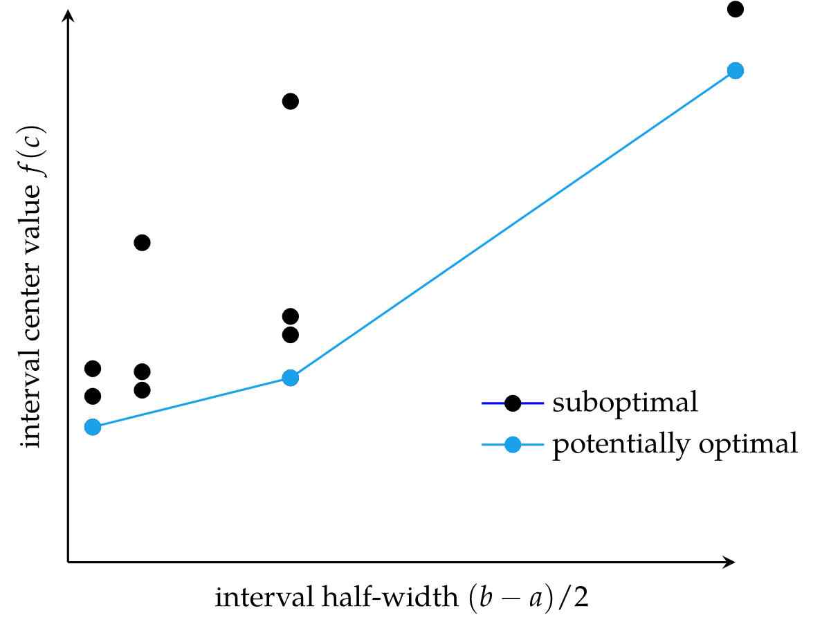
Divided Rectangles
Univariate DIRECT

Slide 17
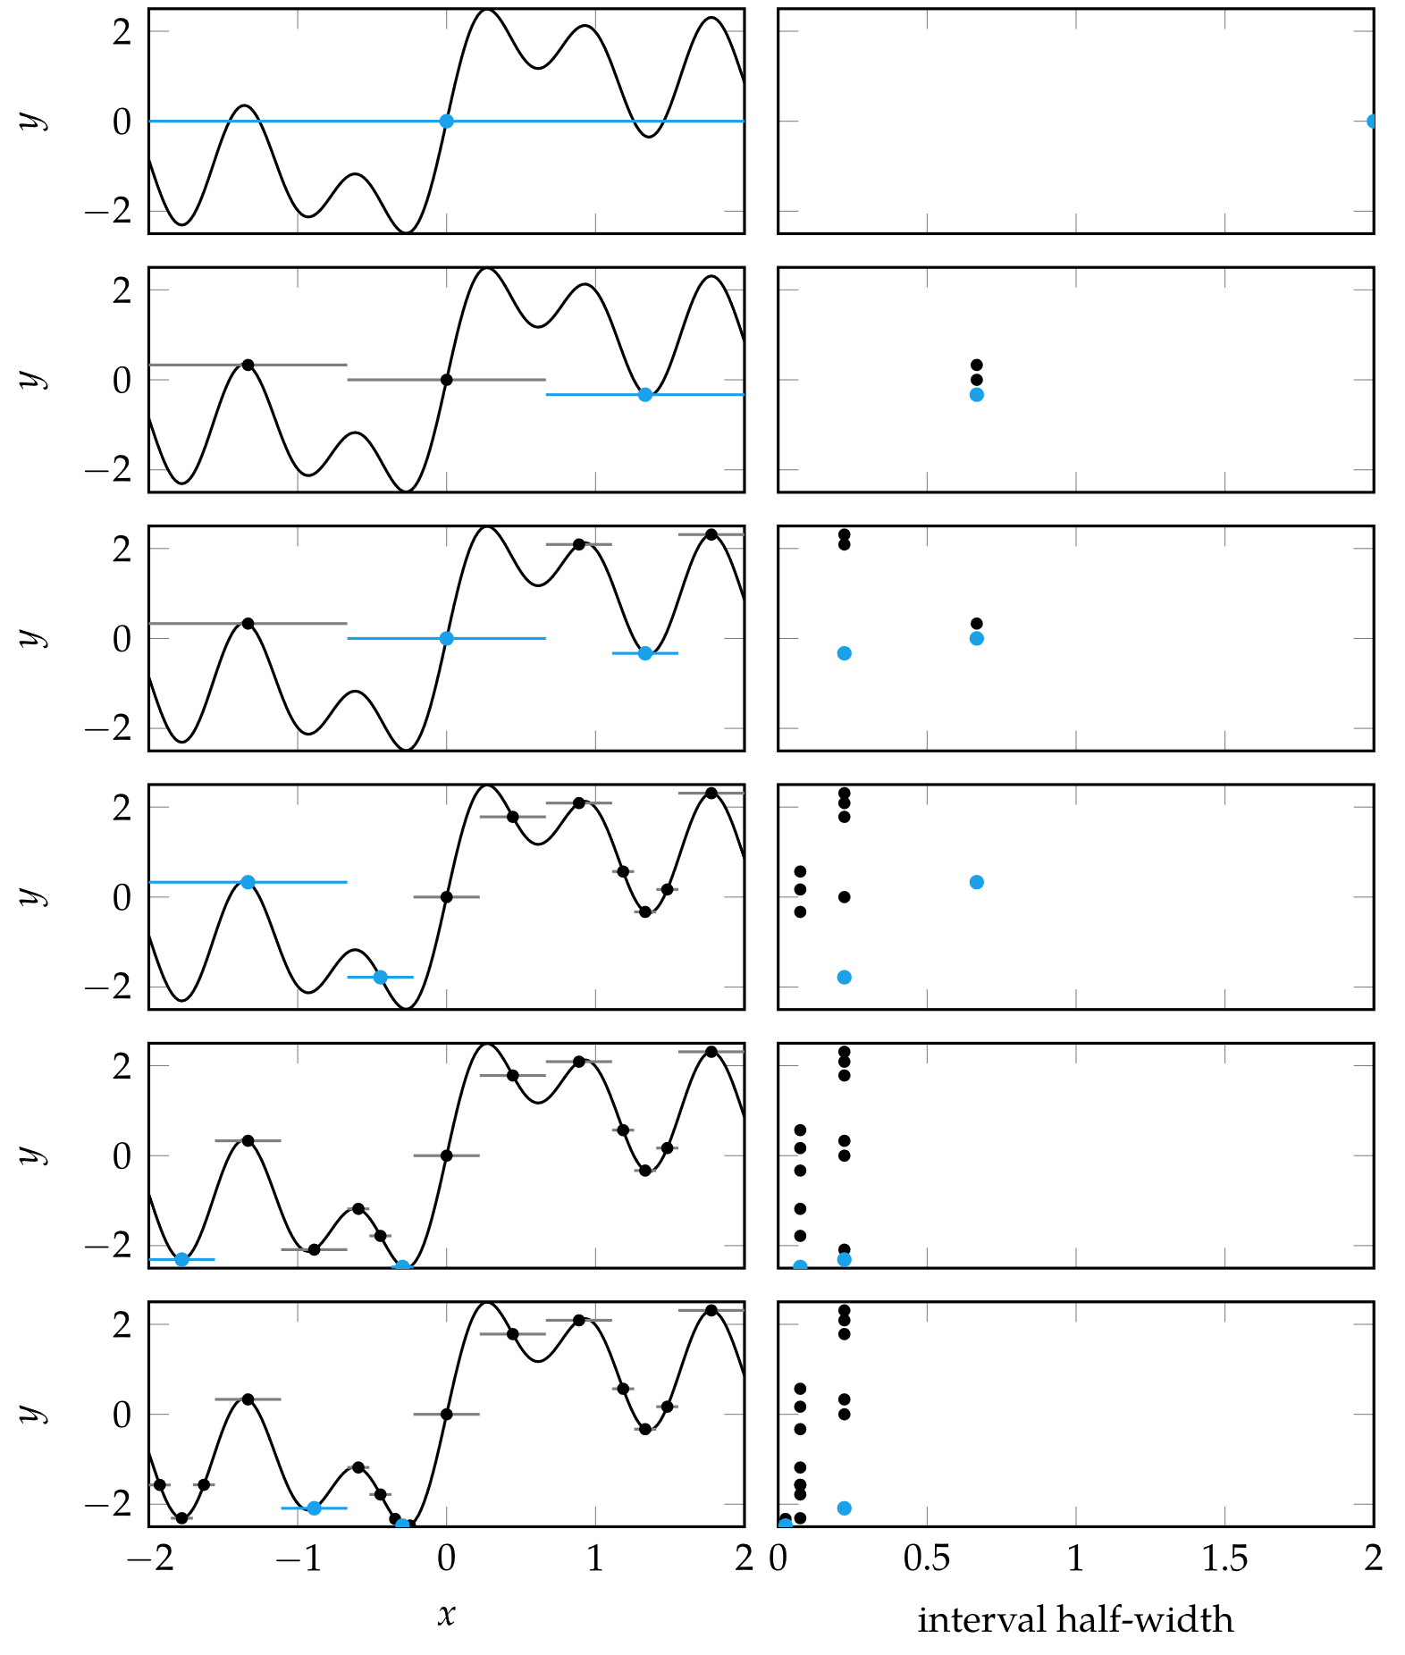
Divided Rectangles

Slide 18
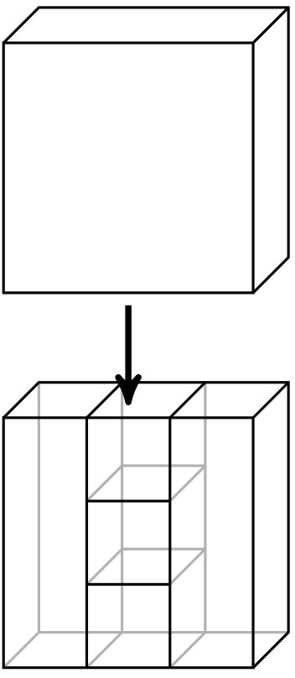
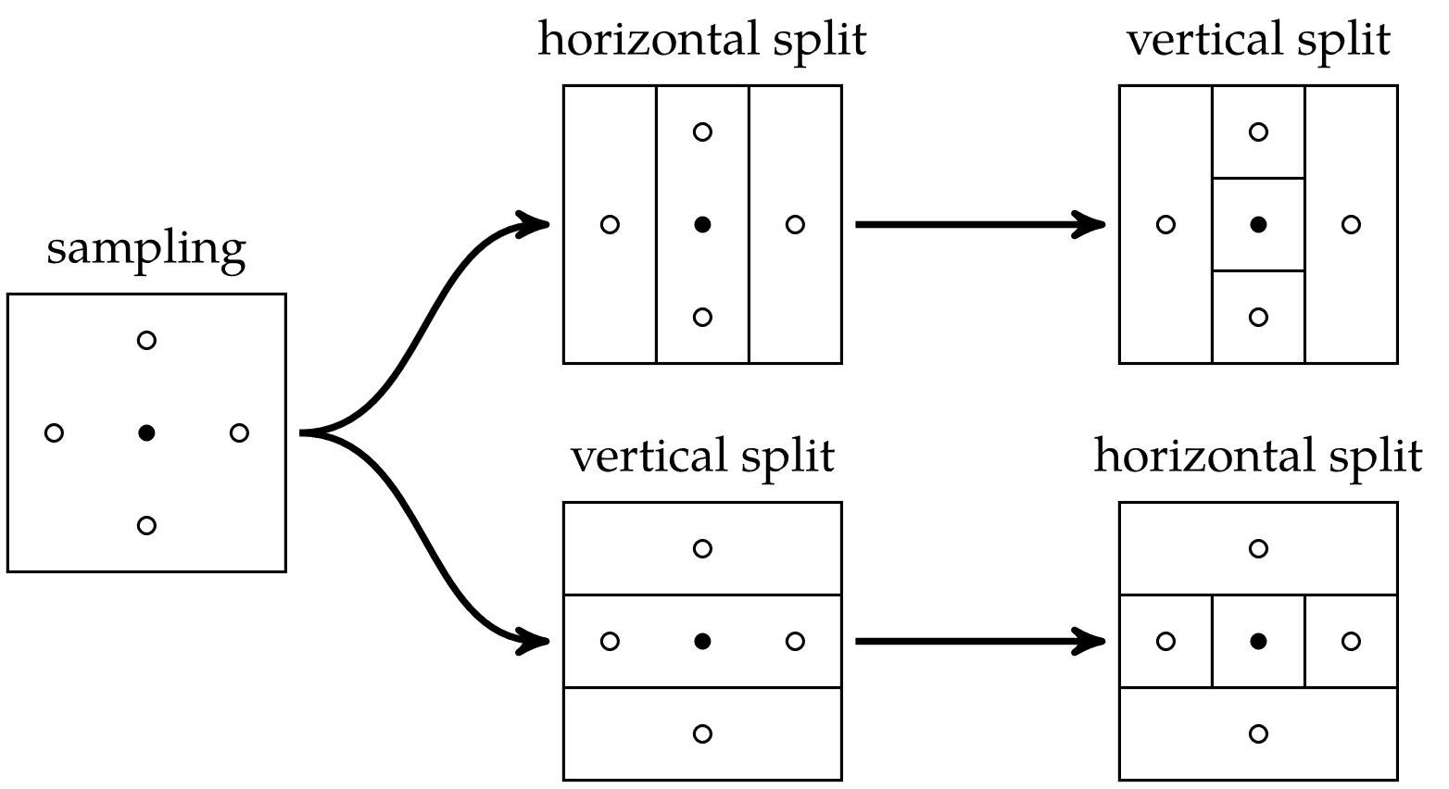
Divided Rectangles
Multivariate DIRECT

Slide 19
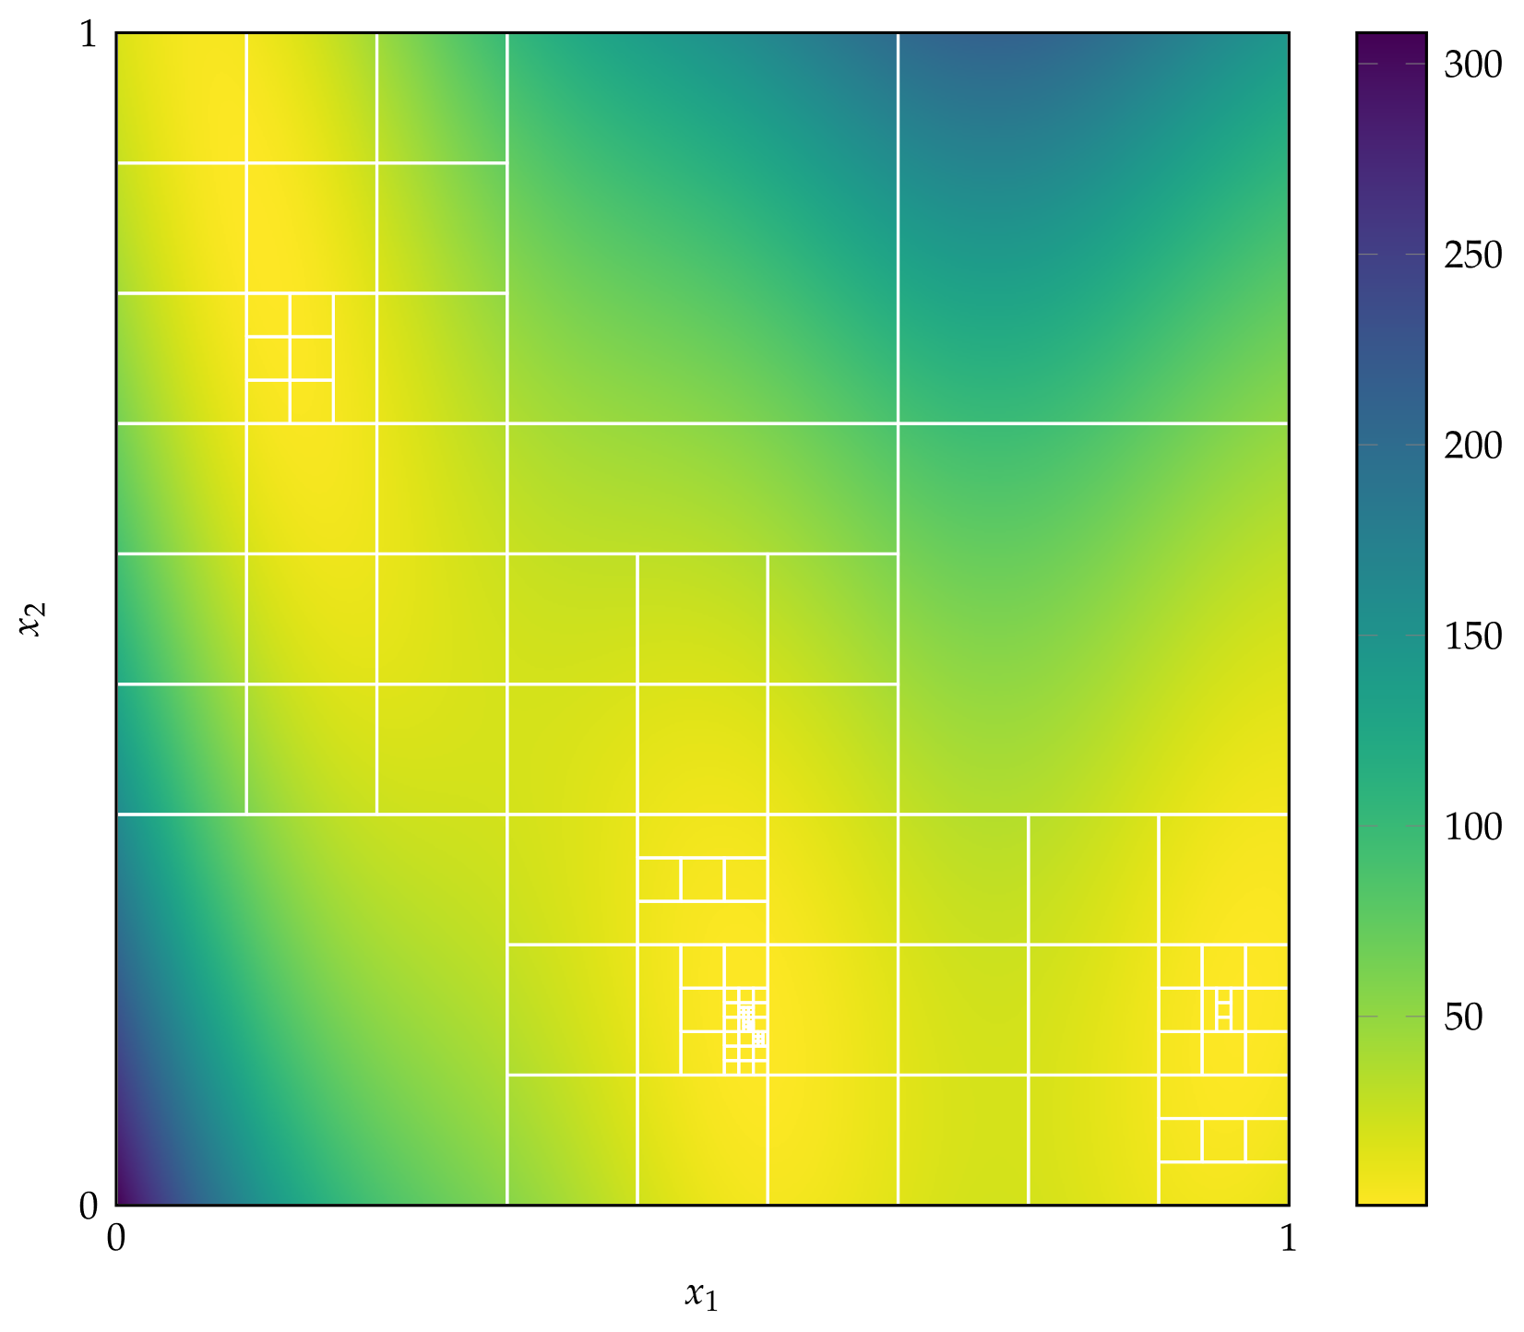
Divided Rectangles

Slide 20
Summary
Direct methods rely solely on the objective function and do not use derivative information.
Cyclic coordinate search optimizes one coordinate direction at a time.
Powell’s method adapts the set of search directions based on the direction of progress.
Hooke-Jeeves searches in each coordinate direction from the current point using a step size that is adapted over time.

Slide 21
Summary
Generalized pattern search is similar to Hooke-Jeeves, but it uses fewer search directions that positively span the design space.
The Nelder-Mead simplex method uses a simplex to search the design space, adaptively expanding and contracting the size of the simplex in response to evaluations of the objective function.
The divided rectangles algorithm extends the Shubert-Piyavskii approach to multiple dimensions and does not require specifying a valid Lipschitz constant.

